Slide 1
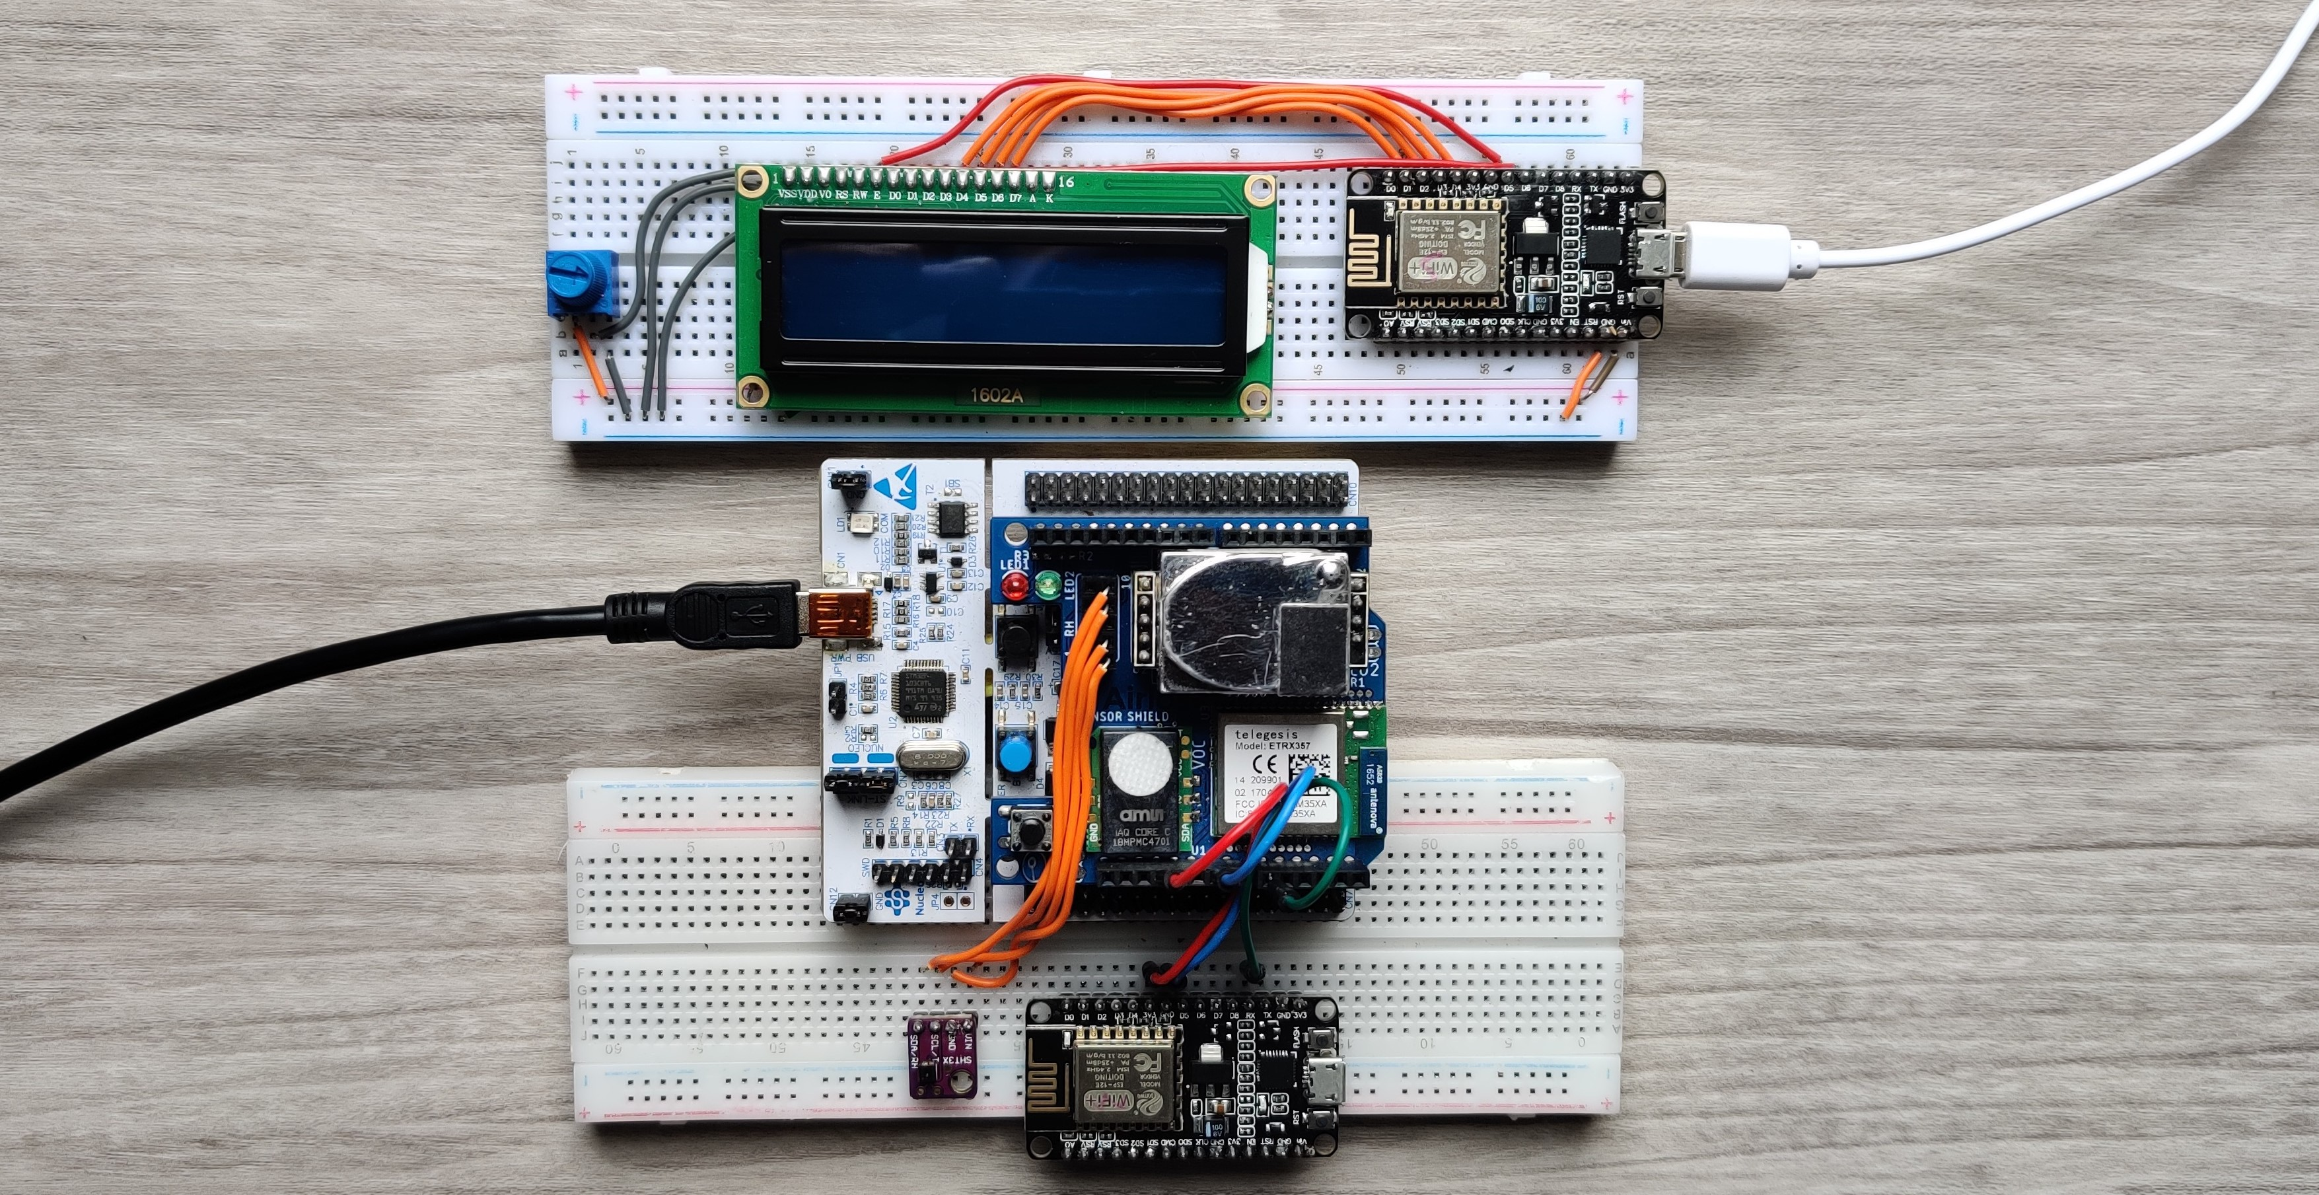
Comfort Home
Final presentation
By Group 7 –
Omar Shekho (SN 3588734), Ilian Stoev (SN 361859) and Danail Georgiev (SN 3781496)

Slide 2
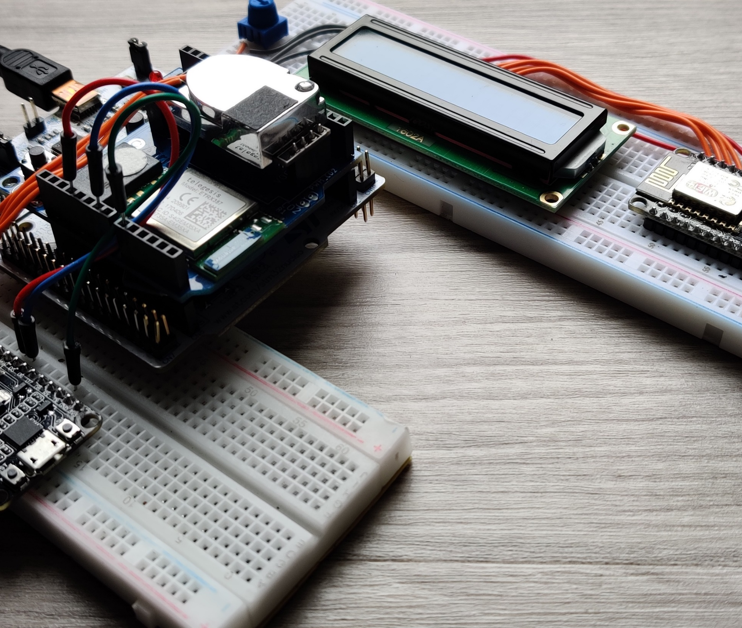
Project introduction
- A simple and elegant system.
- Able to control ventilation of an indoor area using various sensors.
- Cheap and easy to use, it has a place in everyone’s home or workplace.
- Allows data storage and is compatible with other systems.

Slide 3
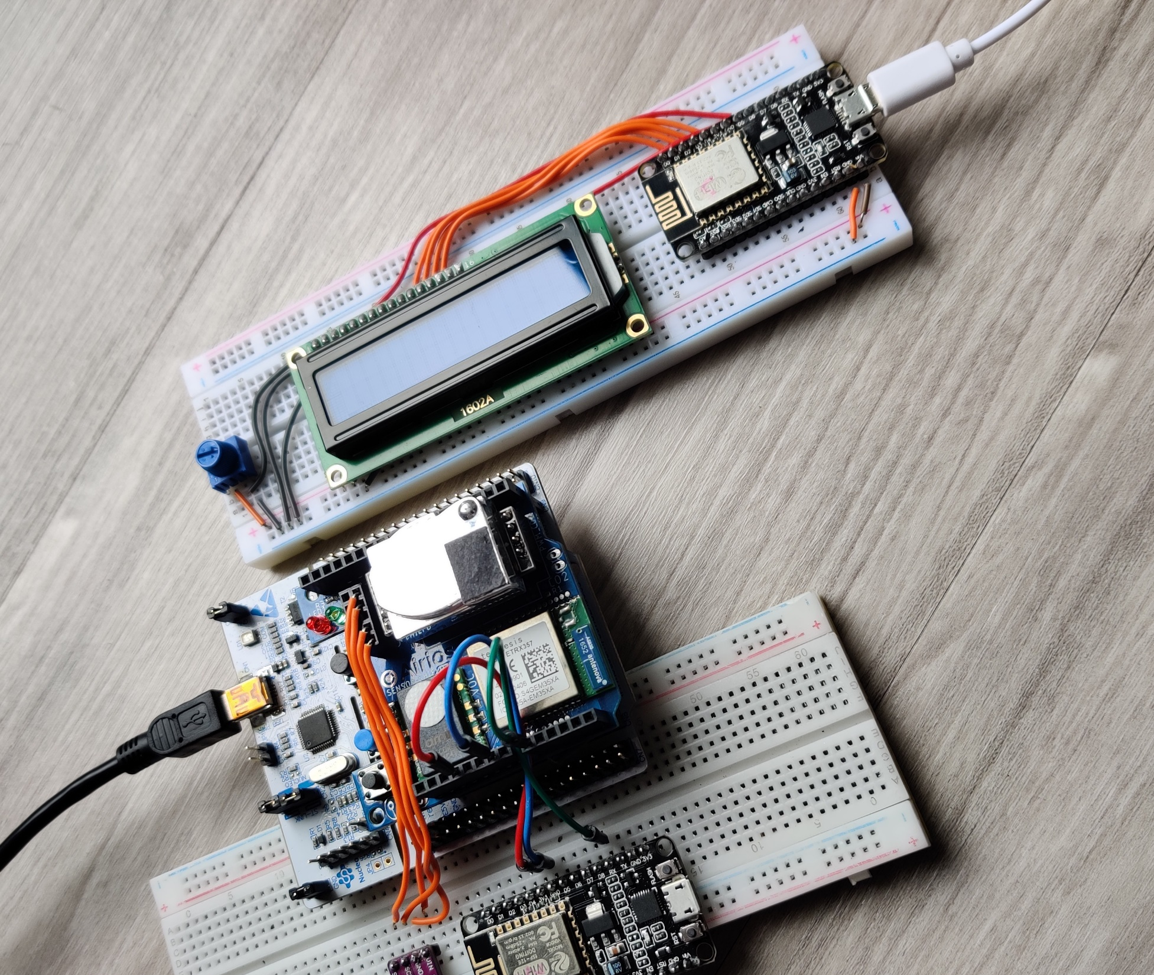
Project description
Project requirements
- Ventilation trigger according to sensor values
- Continuous measuring samples
- Communication between the sensors and the system
- Visual cues
- Duty cycle calculation
- Communication with other modules
- Data logging and extraction

Slide 4
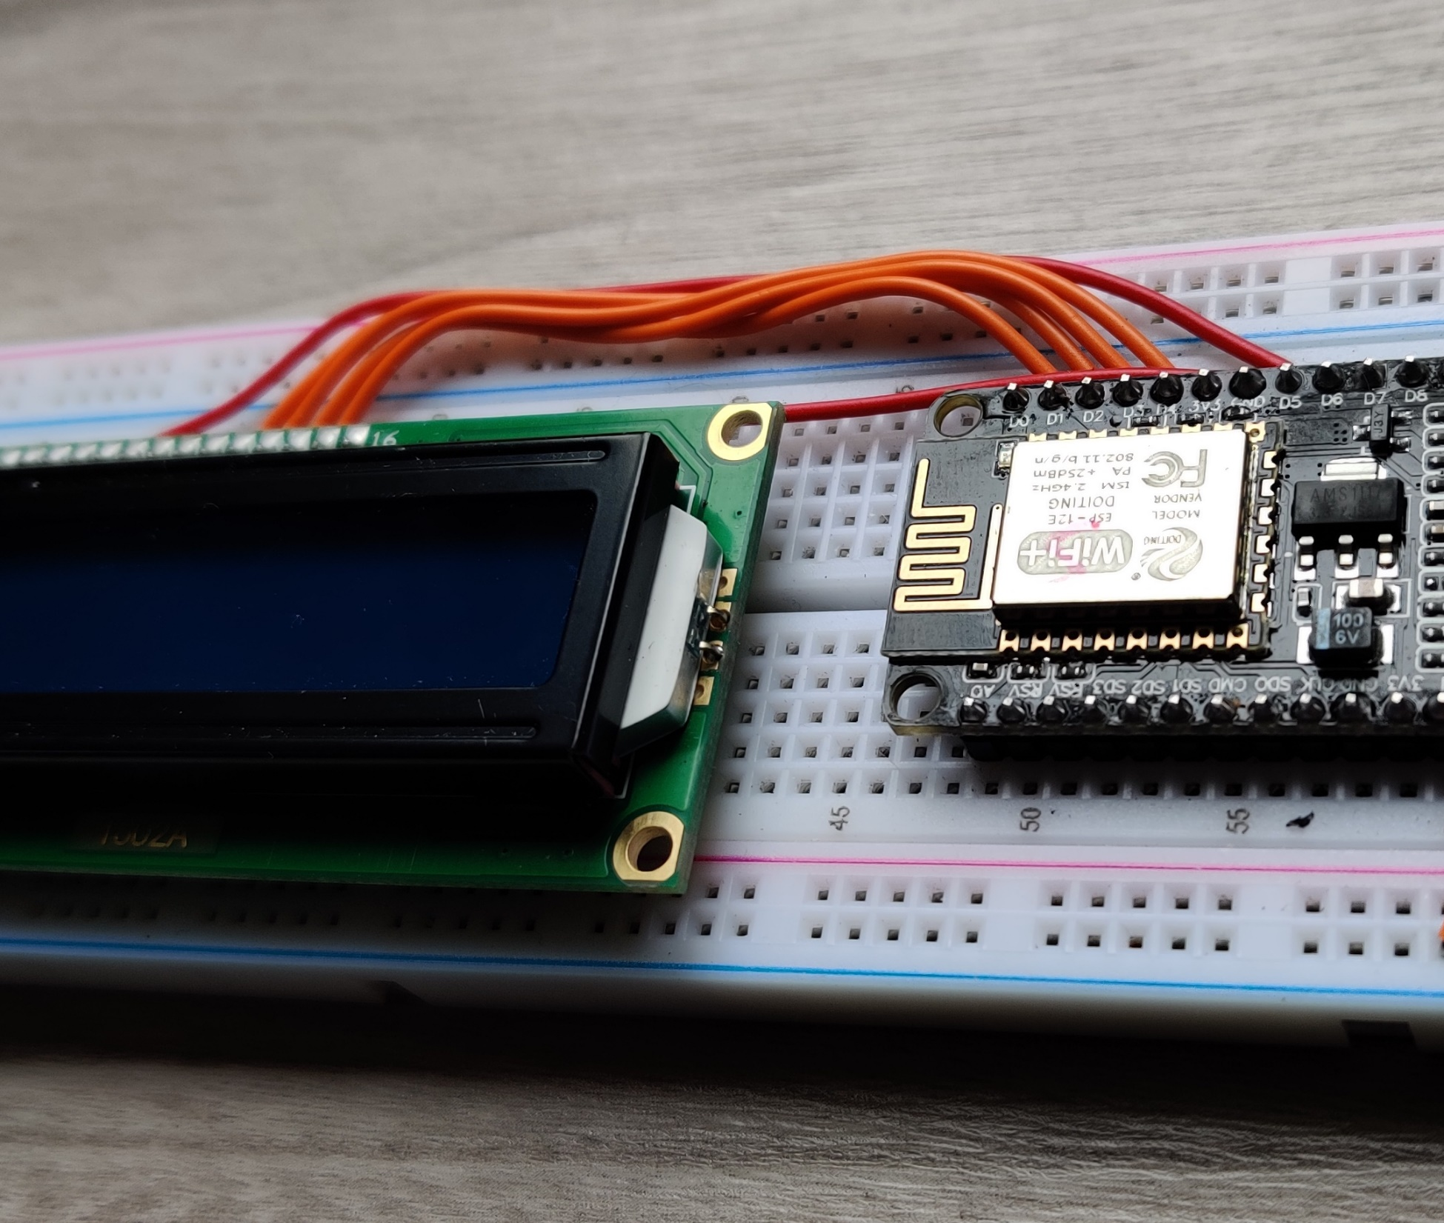
Project Organization
Project way of working
Stand up meeting setups: meetings once a week
Sprint demos: every Monday
Communication: at any time
Tests: planned after every meeting
GitLab for version control

Slide 5
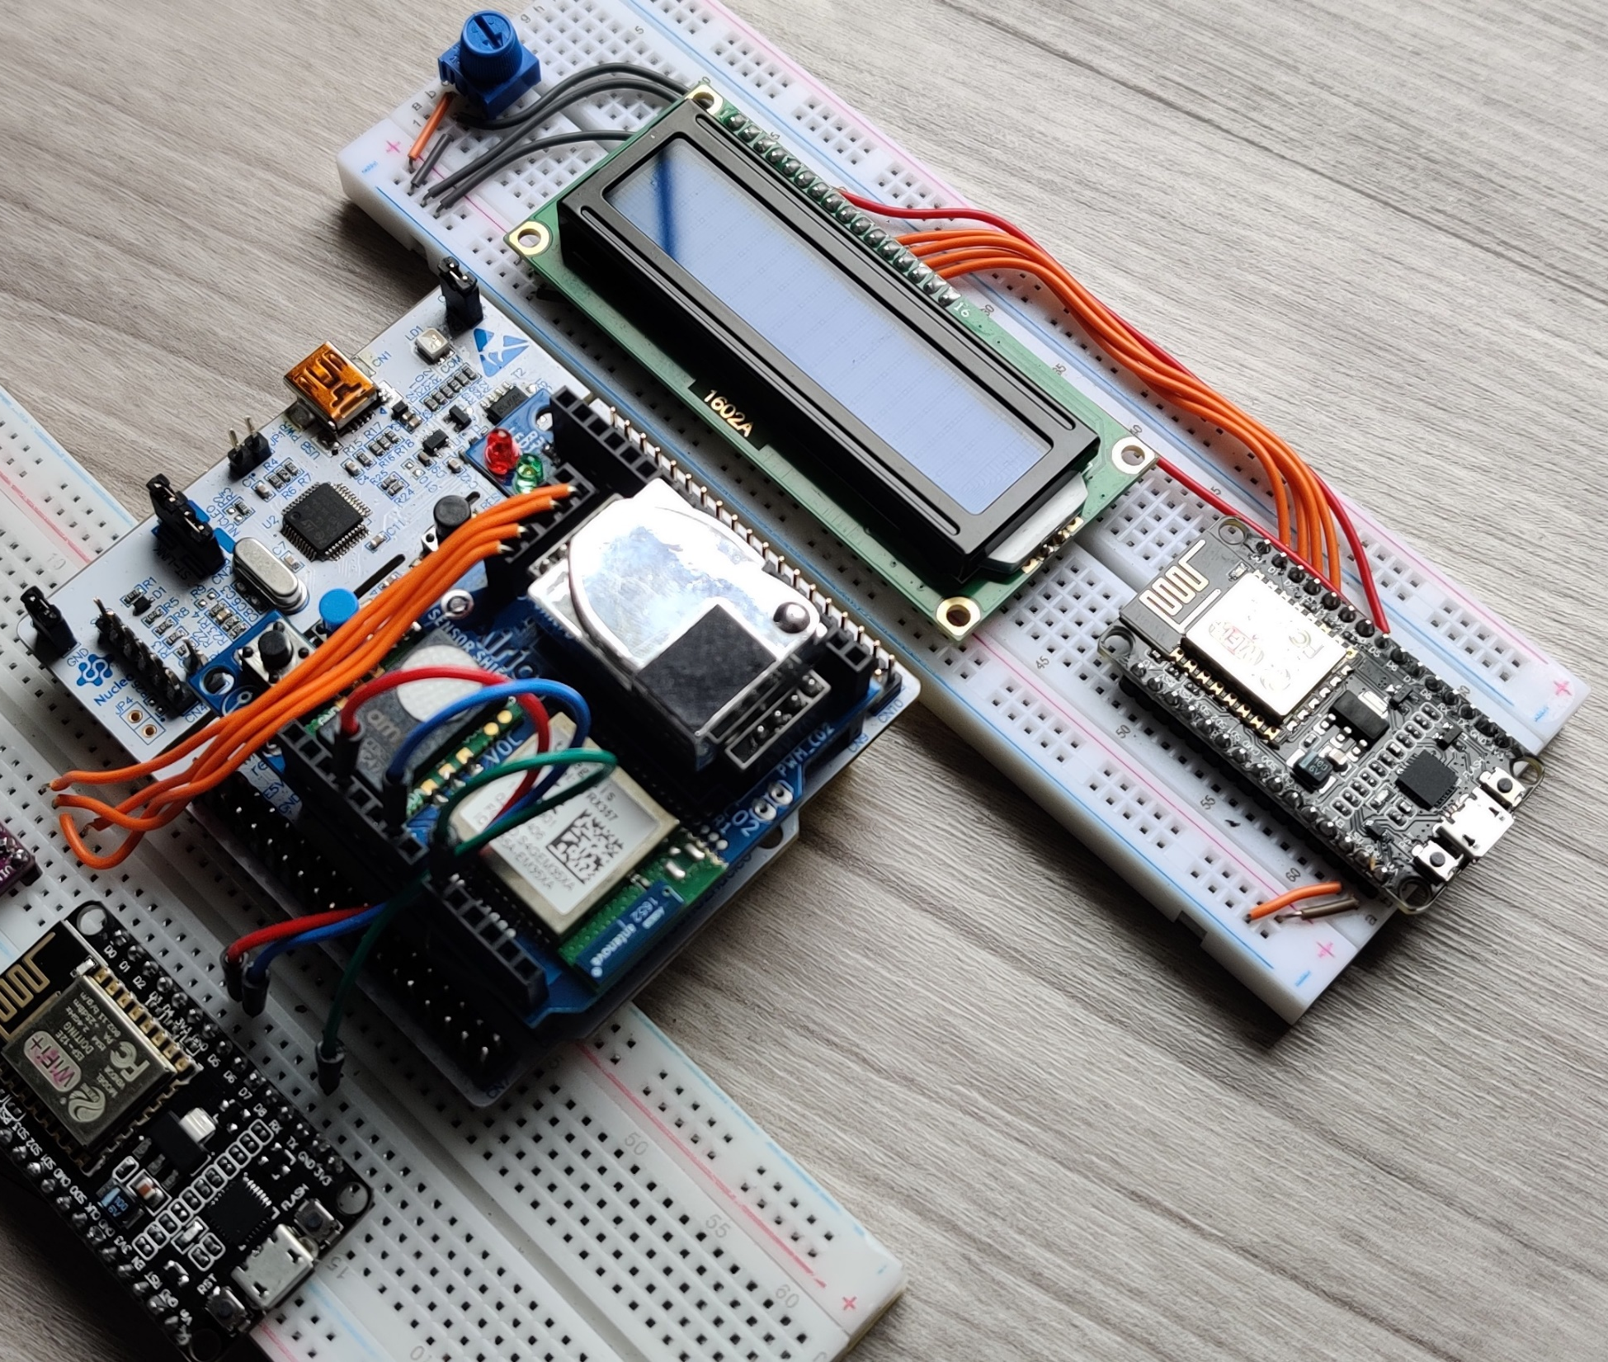
Teamwork challenges
- Team member missing
- Re-distribute tasks
- Adjust workload
- COVID 19
- Team communication
- Time schedule conflicts
- In-person meeting restrictions

Slide 6
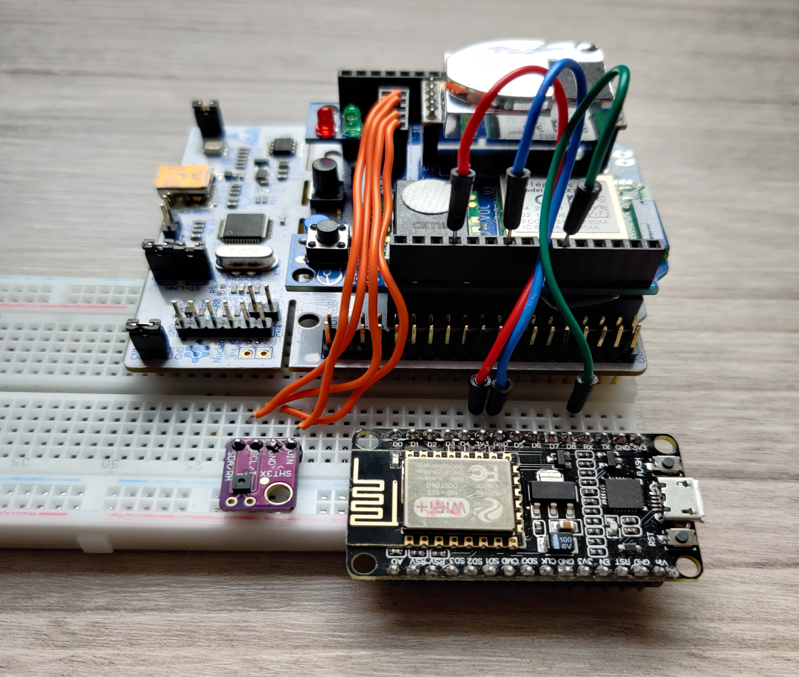
Technical challenges
Learning how the sensors work
Dysfunctional SHT3X sensor
Finding a replacement for the ZigBee
Establishing connection with other boards
Connecting to the database

Slide 7
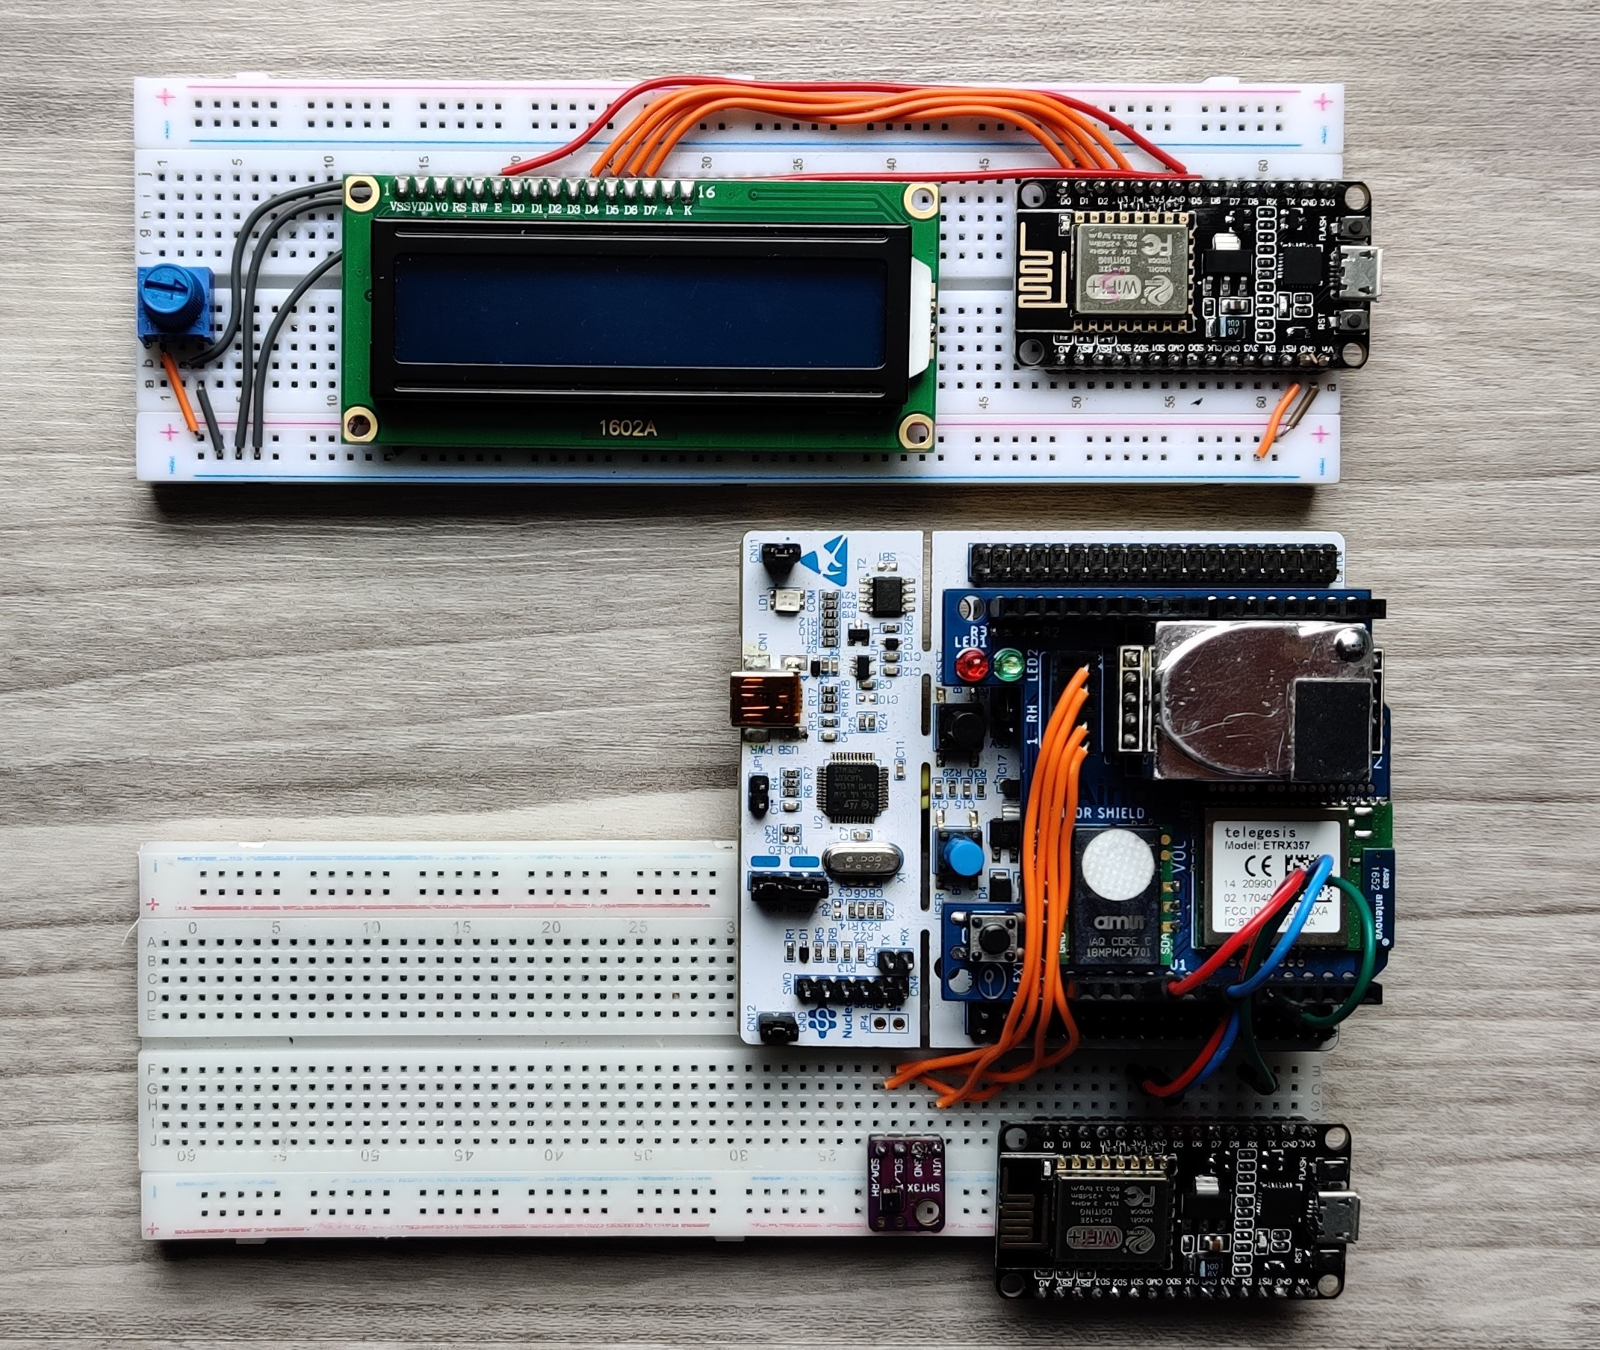
Deliverables:
- Project plan and system design document
- Nucleo and ESP hardware code
- C# application
- System hardware sample
- Project report
+ LCD display

Slide 8
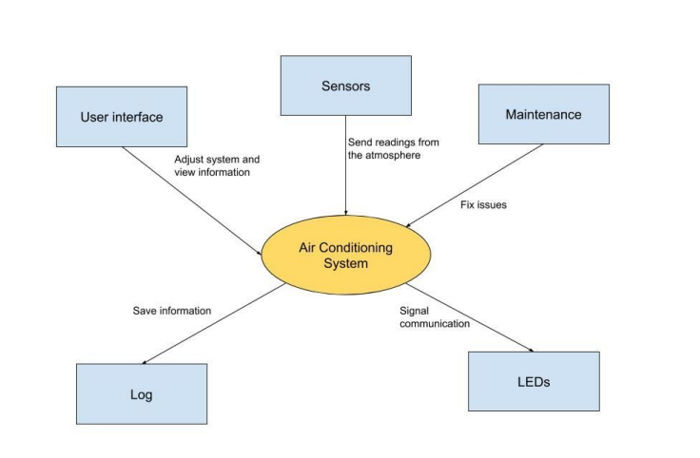
System context diagram

Slide 9
Conclusion & Recommendations
A fully functional ventilation simulation system.
Task planning, testing and good risk management helped us immensely in dealing with these issues that popped up.
We would like to recommend for the UI to be further improved, as well as for more reliable hardware to be obtained.

